Slide 1
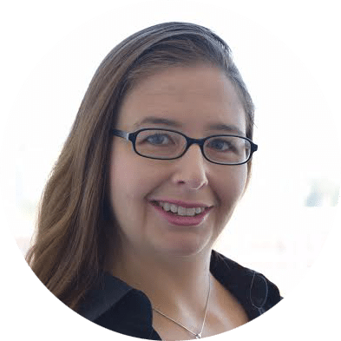
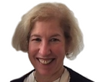
ME/CFS Advocacy Week | Wednesday, April 19, 2017 | 1PM ET / 10AM PT
How to plan your local advocacy: District Meetings
Emily Taylor | Gail Cooper
SMCI | #MEAction
All rights reserved by the Solve ME/CFS Initiative and the Myalgic Encephalomyelitis Action Network
Notes:
Gail

Slide 2
About Our Webinars
Welcome to our ME/CFS Advocacy Week Training!
Webinars are recorded, and the recording is made available on our YouTube channels:
SMCI: http://YouTube.com/SolveCFS
MEAction: https://www.youtube.com/channel/UC2k7yUo-vOLXfsNCl8WSzgg
Notes:
Gail - instruct to use the question box for questions

Slide 3
About This Webinar
Please use the question box to ask questions during the presentation
There will be Q&A at the end of the presentation
Use the “Raise Hand” button during the Q&A to get in line to ask a question
One speaker at a time - Our organizers will unmute individuals for questions
Notes:
Gail - instruct to use the question box for questions

Slide 4
ME/CFS Advocacy Week | Wednesday, April 19, 2017 | 1PM ET / 10AM PT
How to plan your local advocacy: District Meetings
Emily Taylor | Gail Cooper
SMCI | #MEAction
All rights reserved by the Solve ME/CFS Initiative and the Myalgic Encephalomyelitis Action Network
Notes:
Gail

Slide 5
Save the Dates!
Thursday, May 8 - 11: District Advocacy Week
Need to be scheduled meetings NOW.
This webinar covers HOW TO MAKE a meeting request.
Next webinar will cover HOW TO CONDUCT a meeting
Wednesday May 3
Notes:
Emily

Slide 6
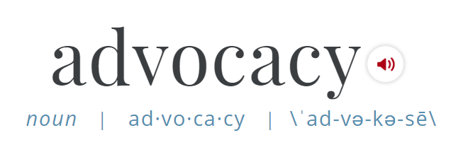
the act or process of supporting a cause or proposal : the act or process of advocating
General information about ME/CFS Advocacy Week
District Actions May 8 – May 11
Schedule a meeting
Prepare for your meeting
Conducting your meeting
6
Notes:
Emily

Slide 7
General advocacy best practices
Be strategic with policy and people
Network
Educate yourself
Prepare and Practice
Persistence and follow-up
Be professional, transparent, and genuine
7
Notes:
Emily

Slide 8
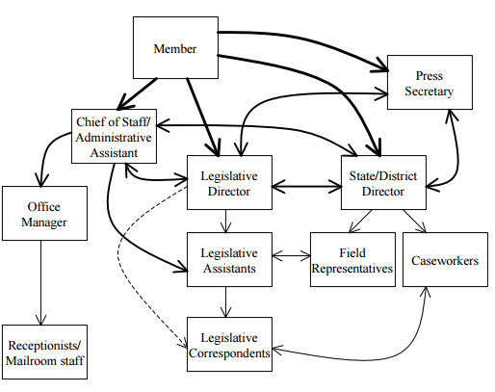
Understanding the Congressional Office
Congressional Staff Reality
© David Chadwick and Steven Yaffe
School of Natural Resources & Enviornment
www.snre.umich.edu
8
Notes:
Emily

Slide 9
How To Find Your Members’ Offices And Contact Them
Finding your member (Representatives and Senators)
http://www.house.gov/representatives/find/
http://www.senate.gov/senators/contact/
These sites will give you the offices’ phone numbers and other contact information.
FYI, you must be a constituent to email a member from site.
9
Notes:
Gail

Slide 10
Best practices: Scheduling your meeting
Call your district office to find out preferred method of request
Submit the request during business hours
Start NOW.
Follow-up to confirm the request was received
Follow-up 1x – 2x per week until the meeting is confirmed
10
Notes:
Gail

Slide 11
Best practices: Meeting Request Must Haves!
Full Name
Full Address (with zip +4)
Requested Date and Time
Clearly request meeting with the Member
Tell them the meeting is about ME/CFS
Part of a nation-wide action
11
Notes:
Gail

Slide 12
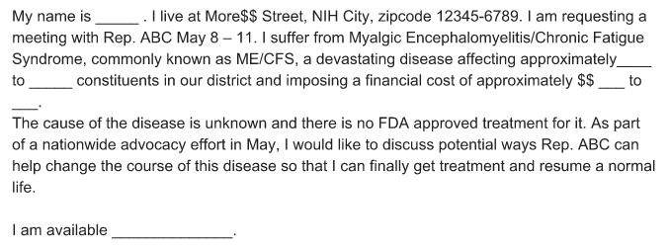
Sample Meeting Request
12
Notes:
Emily

Slide 13
Sample Meeting Follow-up
Dear ________,
I am writing to follow-up on the meeting request for ______ regarding a national effort on ME/CFS which I sent on _______. Do you have any updates regarding Senator/Representative ______________’s schedule? We hope to meet with Senator/Representative _______ directly during the May district work week.
We are/I am available to meet between 1pm - 3pm. Please let me know if there is any additional information I can provide. I look forward to your response.
13
Notes:
Emily

Slide 14
Other Things to Potentially Include
Estimates of disease population/economic impact in your district (See prevalence spreadsheet)
Personal connection? Mention that in your request.
Met with the office before? Mention your previous meeting.
Reasonable accommodations? Someone can accompany you or even speak for you, if needed.
14
Notes:
(GAIL) Additionally,
To find out the population/$$ numbers, use this prevalence spreadsheet. The first tab on the bottom row will take you to the numbers for your state. The remaining tabs on the bottom will take you to the numbers for each district in the states listed in that tab and includes the name of your representative and the number of people affected with
ME/CFS in his/her district. (If you need help with this, email congress@meaction.net).This will go into your talking points.You can also include the economic impact in your state which is also included on the spreadsheet.
If you have a personal connection, be sure to mention that in your request.
If you’ve met with the office before, consider referring to your previous meeting.
You are requesting a meeting with your representative. However, if you cannot get a meeting with her/him, ask to meet with the director of the district office. If that fails, ask to meet with someone who works on health issues.
FYI, If you need a reasonable accommodation for the meeting, you can have someone accompany you or even speak for you.

Slide 15
Best practices: Prepare for your meeting
Start thinking about how you will tell your story.
Be positive. Do not make accusations/assumptions.
Prepare to be brief.
Do your research (eg. How many people with ME/CFS in your district?)
Review your leave-behinds (Don’t forget contact info!)
Check your facts
Practice your presentation
15
Notes:
(GAIL) IV. Additional Best Practices Pre-Meeting
In the next webinar, we’ll go over the written briefing materials/talking points we’re preparing, along with the “asks” for this action. They will include the basic facts to cover. In the meantime, start thinking about how you will tell your story. Succinctly describe your history and the impact ME/CFS has had on you and, as appropriate, loved ones.
Depending on whether you are the sole speaker or not, you may only have 3-5 minutes to tell your story. And 15 minutes for the whole meeting. So try to do at least one dry run of your remarks with the participants...and with a timer!
As valid as all our critiques are of the government’s failures the last thirty years, that should not be the focus of the meeting. Emphasizing the negatives typically turns off people instead of engaging them.
If you haven’t already done so, see if you can find anything about the staffer/member you’re meeting with that might help to make a positive, personal connection. You can find a lot of information on the members’ websites which may give you a clue to a possible connection.

Slide 16
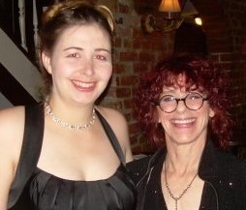
Sample Storytelling: Do’s and Don’ts
Do be honest
Don’t be negative (just the facts)
Do make it personal
Don’t get distracted
Do link to your asks
Don’t make accusations/assumptions
16
Notes:
Emily

Slide 17
The Day Before
Call and email the staff to confirm the meeting.
Make/bring several extra copies of the handouts that we will send you.
17
Notes:
EMILY IV. Additional Best Practices Pre-Meeting
In the next webinar, we’ll go over the written briefing materials/talking points we’re preparing, along with the “asks” for this action. They will include the basic facts to cover. In the meantime, start thinking about how you will tell your story. Succinctly describe your history and the impact ME/CFS has had on you and, as appropriate, loved ones.
Depending on whether you are the sole speaker or not, you may only have 3-5 minutes to tell your story. And 15 minutes for the whole meeting. So try to do at least one dry run of your remarks with the participants...and with a timer!
As valid as all our critiques are of the government’s failures the last thirty years, that should not be the focus of the meeting. Emphasizing the negatives typically turns off people instead of engaging them.
If you haven’t already done so, see if you can find anything about the staffer/member you’re meeting with that might help to make a positive, personal connection. You can find a lot of information on the members’ websites which may give you a clue to a possible connection.

Slide 18
Thank you for joining us!
All rights reserved by the Solve ME/CFS Initiative
18
Notes:
Emily

